Slide 1

MATLAB Programming
Programming Assignment Two
How to fix bugs?

Slide 2
Implementation of a dynamic system
A dynamic system is updated by two rules as follows.
R1) p ← p + k v Δt
R2) t ← t + Δt
The initial condition is as follows: p = 15, v = -1.0, t = 0, and Δt = 0.001.
Draw a curve of p versus t for each k inside [-1:0.1:1]. t is inside [0,20].
Plot all the curves on the same figure.

Slide 3
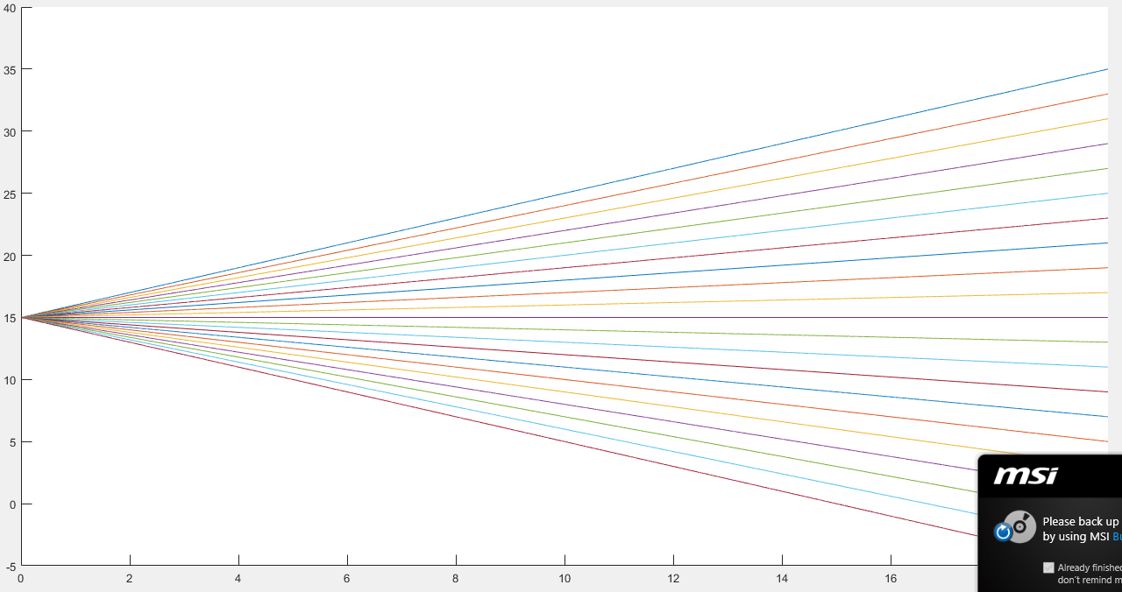
R1) p ← p + k v Δt
R2) t ← t + Δt

Slide 4
clear; clc; clf;
dt = 0.001;
p0 = 15; v0 = -1; t0 = 0;
tmax = 20;
figure, hold on
for k = [-1:0.1:1]
% reset variables to initial condition for each curve
p = p0; v = v0; t = t0; M = []; T = [];
while t < tmax
p = p + k*v*dt;
T = [T,t]; % expand T when necessary. This is slow.
M = [M,p]; % expand M when necessary. This is slow.
t = t + dt;
end
plot(T, M);
end

Slide 5
Do we have a bug?

Slide 6
clear; clc; clf;
dt = 1;
p0 = 15; v0 = -1; t0 = 0;
tmax = 20;
figure, hold on
for k = [-1:1]
% reset variables to initial condition for each curve
p = p0; v = v0; t = t0; M = []; T = [];
while t < tmax
p = p + k*v*dt;
T = [T,t]; % expand T when necessary. This is slow.
M = [M,p]; % expand M when necessary. This is slow.
t = t + dt;
end
plot(T, M, T, M, 'o');
end

Slide 7
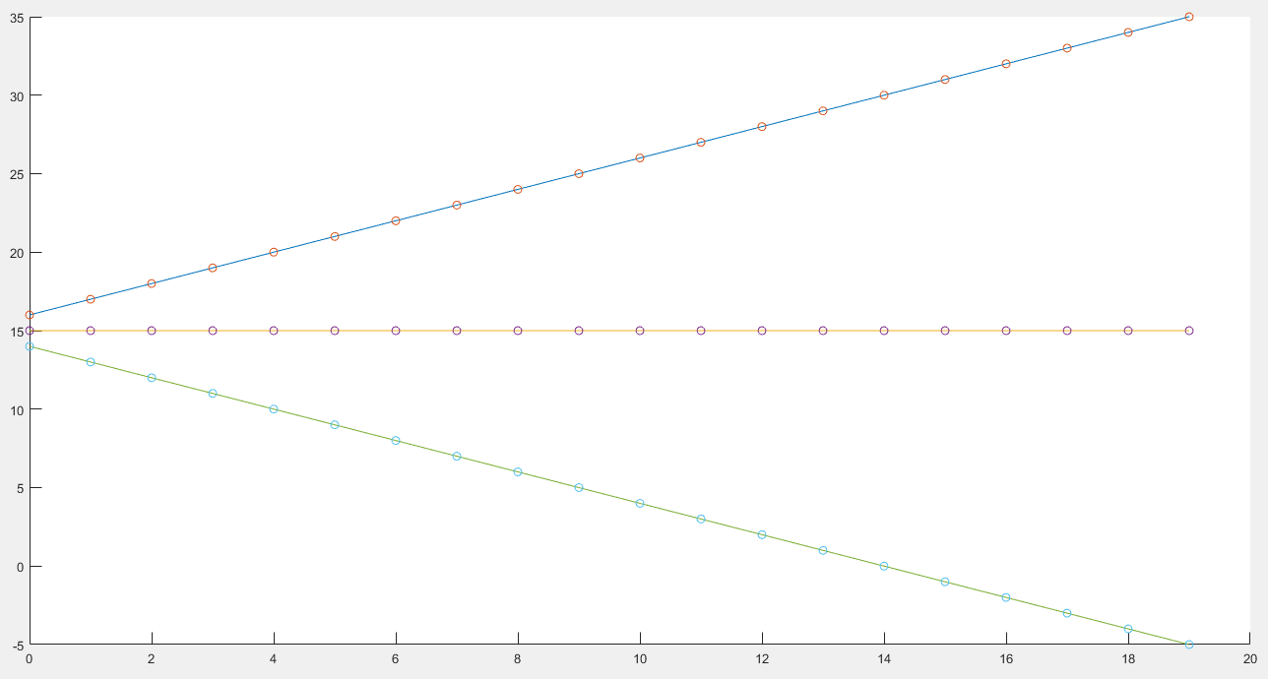

Slide 8
dt = 1;
p0 = 15; v0 = -1; t0 = 0;
tmax = 20;
figure, hold on
for k = [-1:1]
% reset variables to initial condition for each curve
p = p0; v = v0; t = t0; M = []; T = [];
while t < tmax
p = p + k*v*dt;
T = [T,t]; % expand T when necessary. This is slow.
M = [M,p]; % expand M when necessary. This is slow.
t = t + dt;
end
plot(T, M, T, M, 'o');
end

Slide 9

% Bug Fixed
dt = 1;
p0 = 15; v0 = -1; t0 = 0;
tmax = 20;
figure
hold on
for k = [-1:1]
p = p0; v = v0; t = t0; M = [p]; T = [t];
while t < tmax
p = p + k*v*dt;
t = t + dt;
T = [T,t]; % expand T when necessary. This is slow.
M = [M,p]; % expand M when necessary. This is slow.
end
plot(T, M, T, M, 'o');
end

Slide 10
End
Enjoy MATLAB Programming.

